Slide 1
Data 607 Final project Jiaxin Zheng

Slide 2
Research question:
Do higher temperatures result in more severe hurricanes or floods?

Slide 3
About datasets:
NOAA Storm Events Dataset 2023
NASA Power API 2023
It will provide detailed information about the natural disasters, including date, event type and location.
It will supply climate temperature and precipitation to the locations and time periods of the disasters. (only can get one location at a time, So I will compare Temperature vs. Locations (Florida and New York))
Notes:
By analysis, these datasets will highlight the influence of climate change on Hurricanes or floods.

Slide 4
NOAA Storm Events Dataset

Slide 5
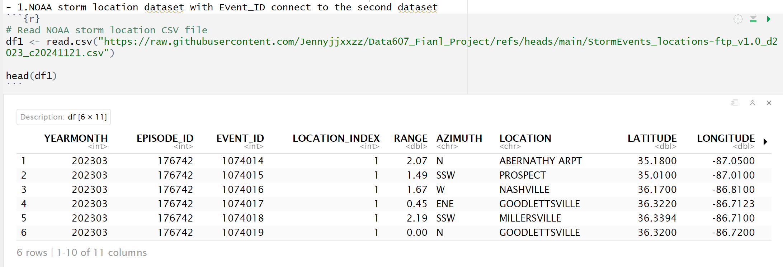
1. read the two cvs files from NOAA Storm Events Dataset

Slide 6
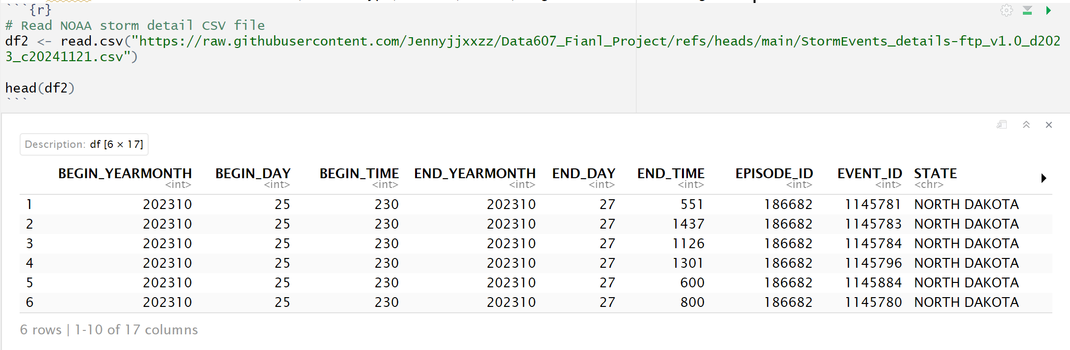
2. NOAA's detail CSV file with date, event type, source, state, begin latitude and longitude.

Slide 7
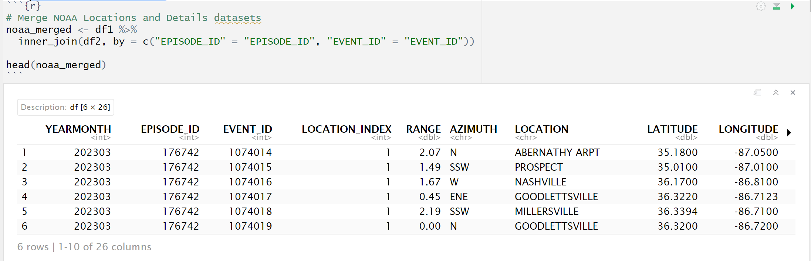
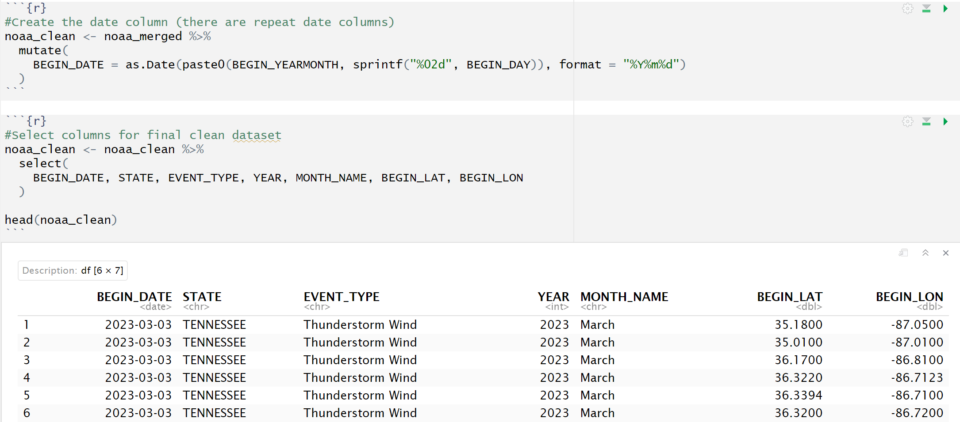
Merge the two CSV files

Slide 8
NASA Power API

Slide 9
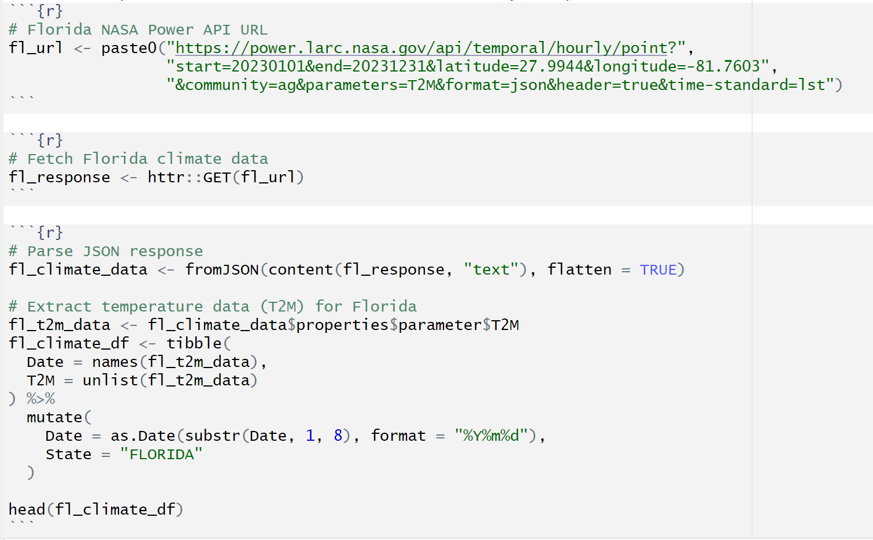
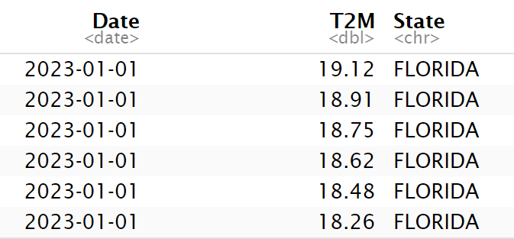
Pull out the data from NASA Power API (Only can pull out one location at a time). (This is for Florida)

Slide 10
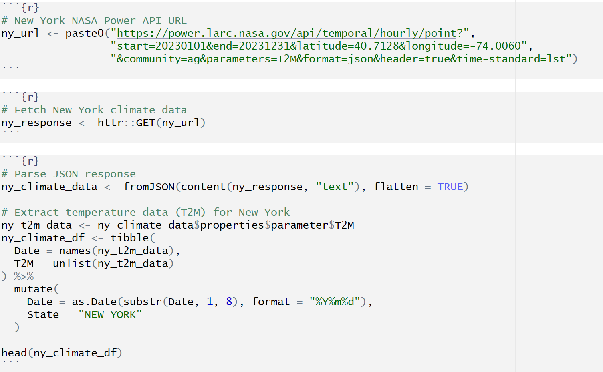
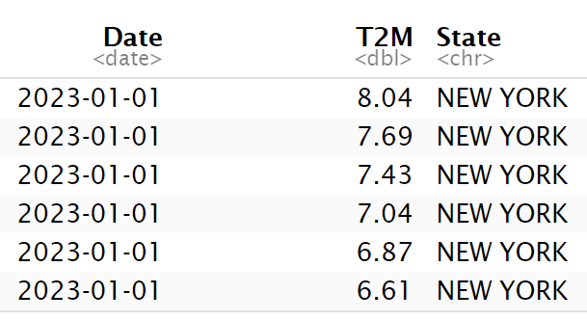
Get Url_2 temperature data for New York.

Slide 11
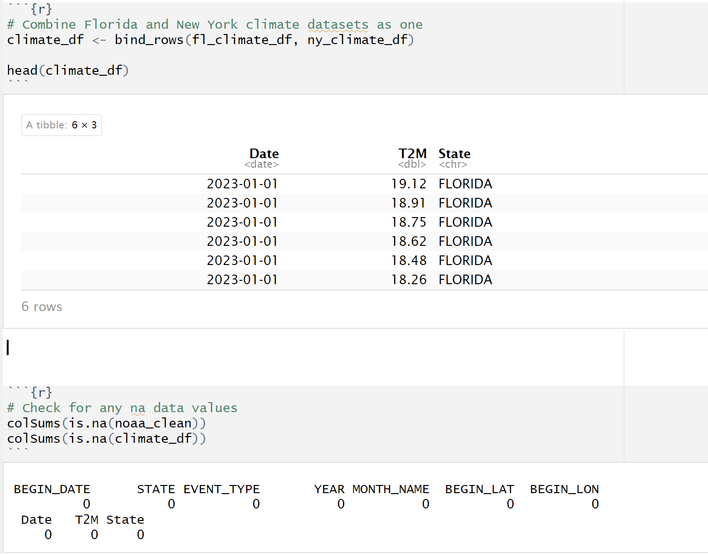

Slide 12
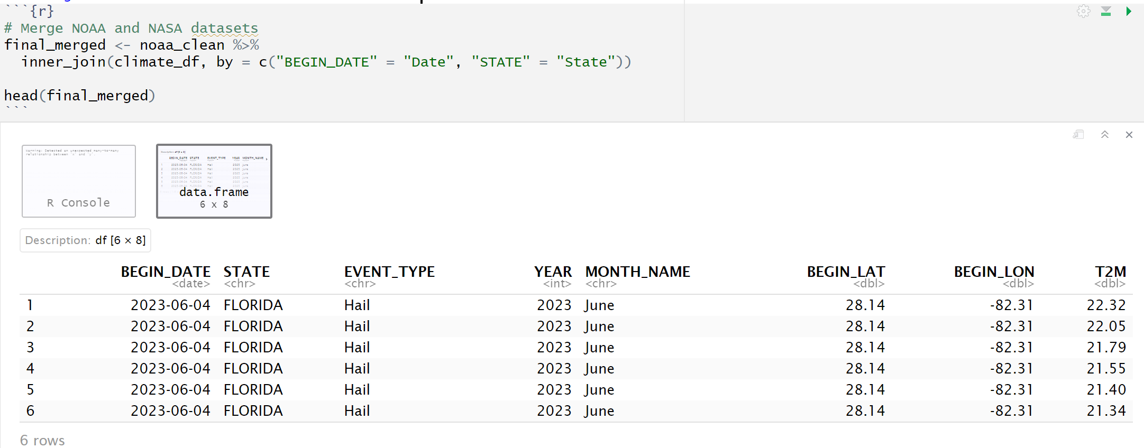
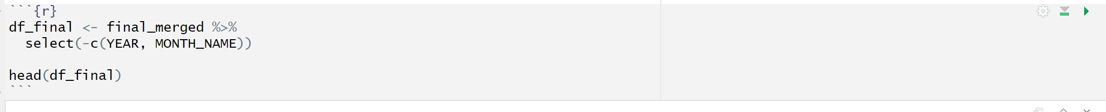
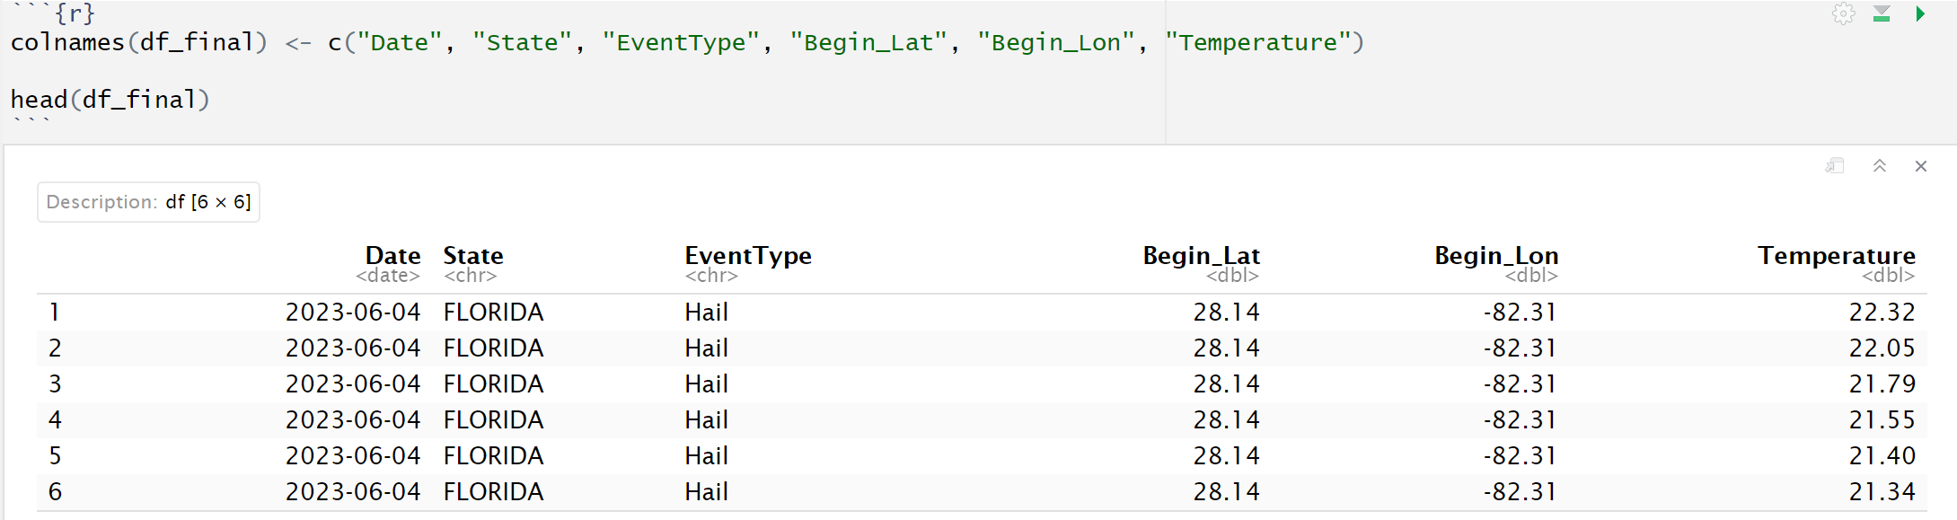
Merge NOAA and NASA datasets as final dataset

Slide 13
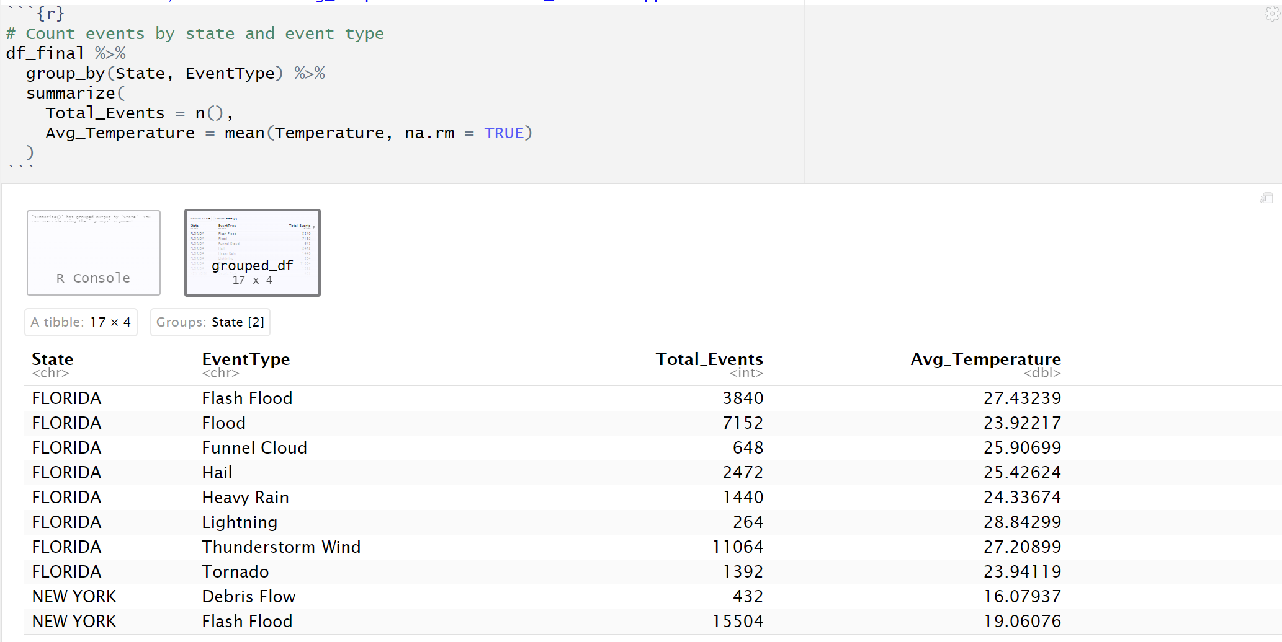
In this data, we see the avg_temperature and total_events happened in state Florida and New York

Slide 14
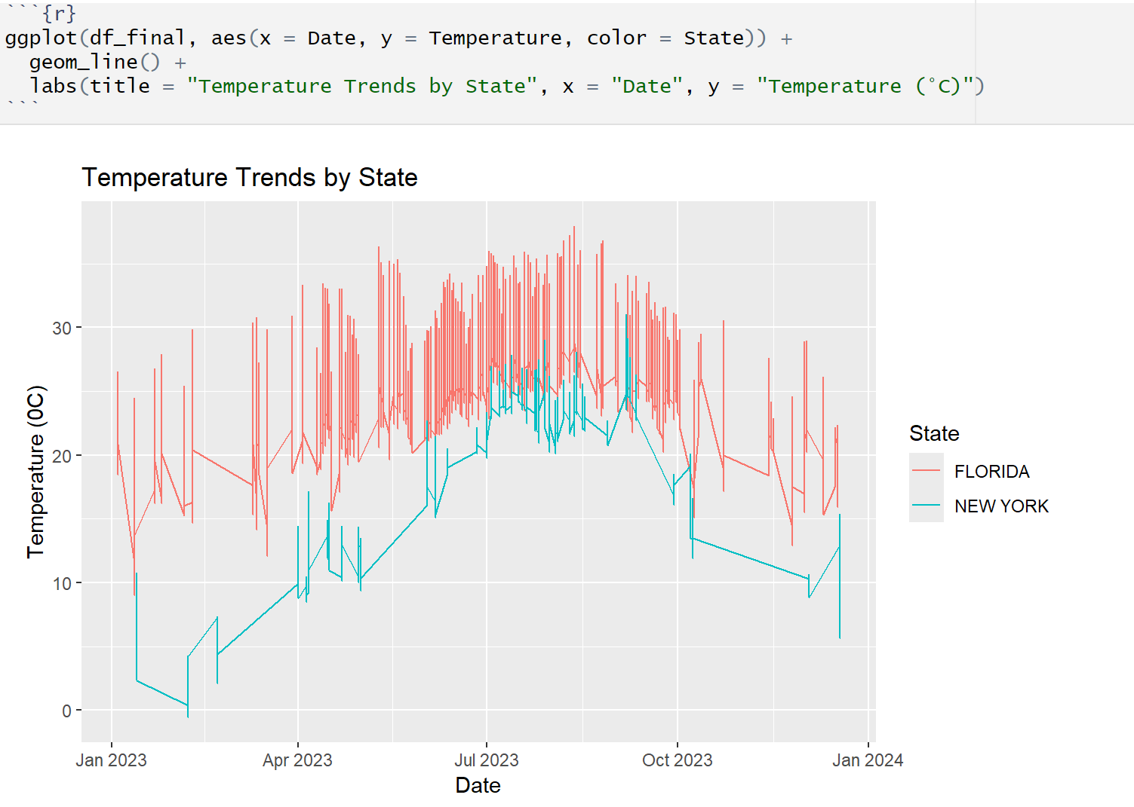
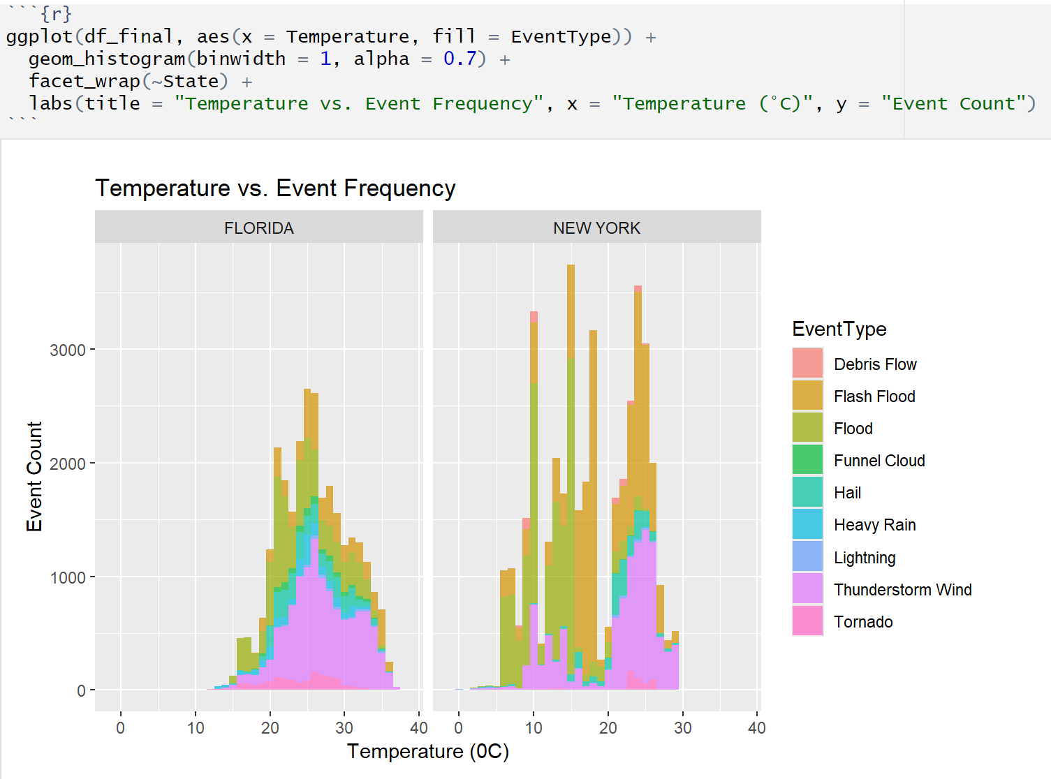

Slide 15
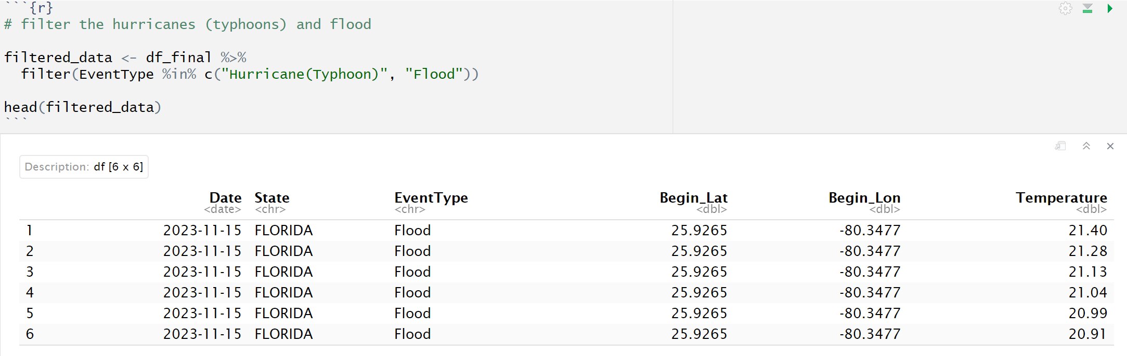
Now, we focus on hurricanes (typhoons) and floods in the year 2023 to examine whether higher temperatures influence the frequency of these events.
- There is no hurricanes (typhoons) were recorded in the New York and Florida areas during this period

Slide 16
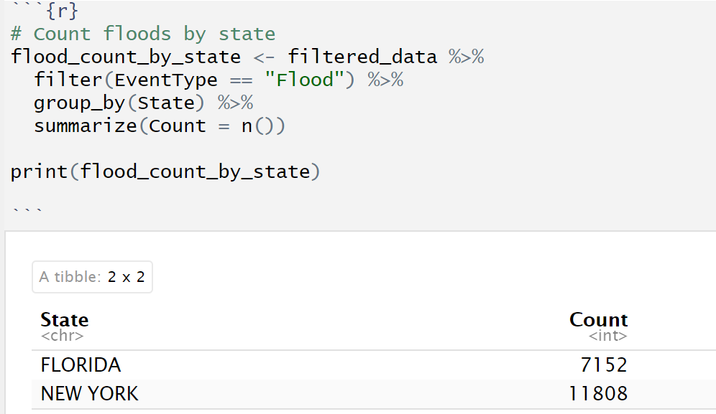
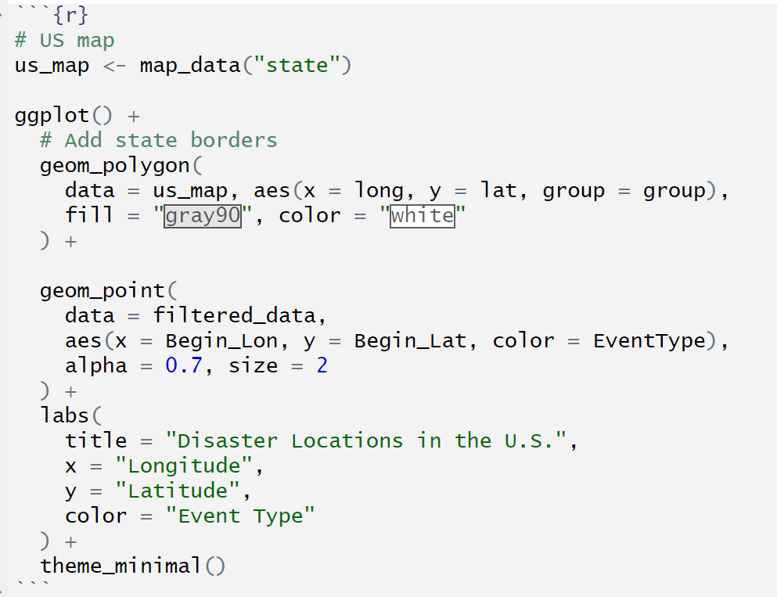
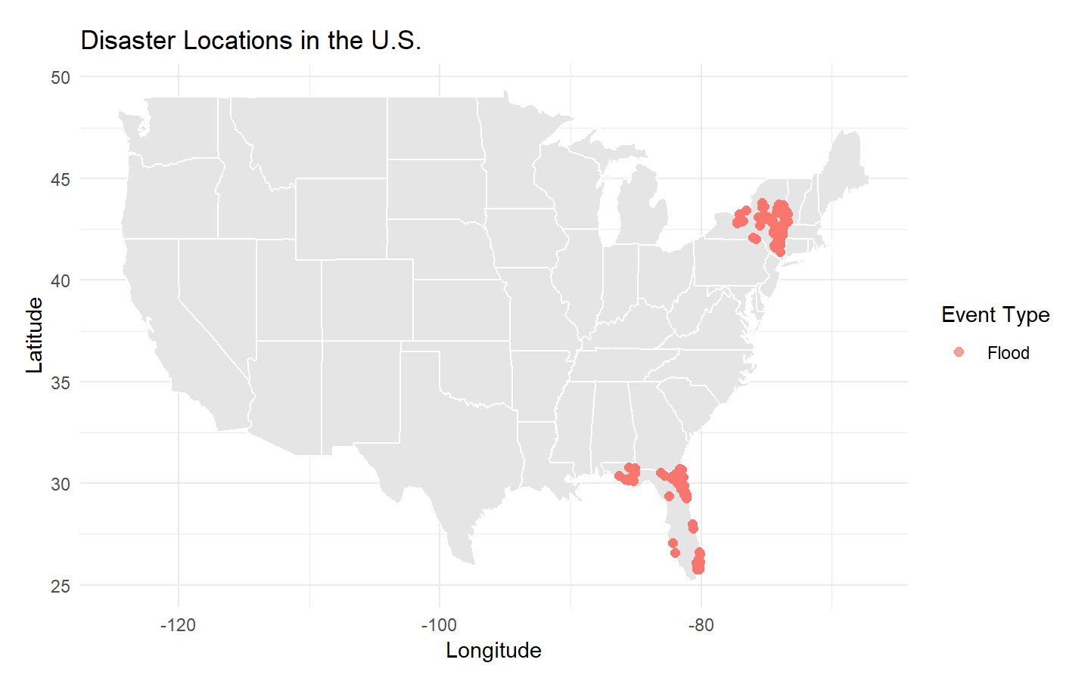

Slide 17
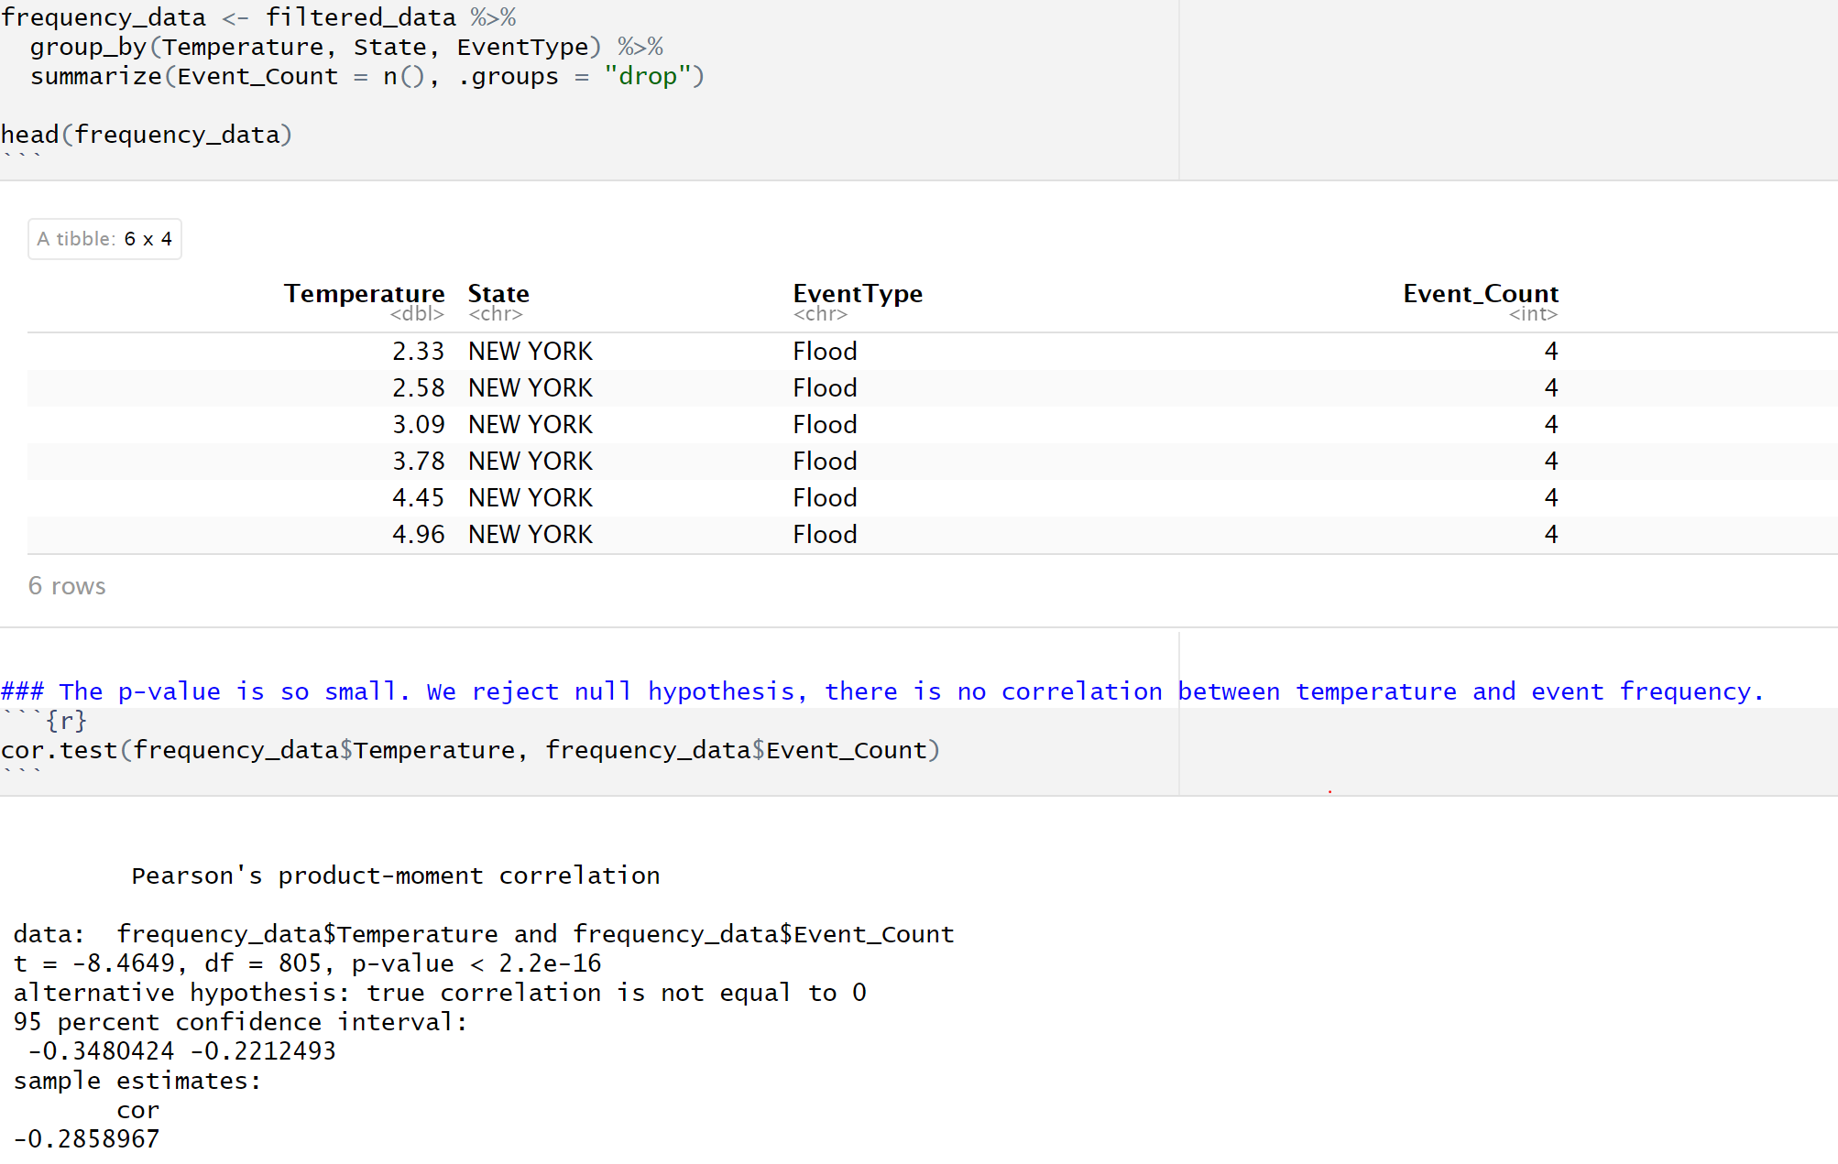
Use cor.test function to assess the relationship between two variables, and test the significance

Slide 18
Summary:
The analysis supports that higher temperatures do not result in more frequent natural disaster. Florida has warmer climate with higher average temperatures compared to New York, but in year 2023, New York experienced more floods(11,808 events) than Florida (7,152 events). Temperature may be one influencing factor, but flood frequency appears to be determined by a combination of climatic and environmental factors.

Slide 19
Challenges:
This project was particularly challenging for me because it required merging two separate NOAA CSV files and merging them with the NASA API dataset. Additionally, creating a map plot to visualize the data was a new and complex task that pushed me to learn and apply new skills.

Slide 20
Thank you

